Slide 1

Pandit Deendayal Energy University
Summer Internship Evaluation
Prepared by :
Dev Jethva
(23MDS003)
Under the guidance of
Dr. Yogesh Kumar
Topic
White Blood Cell Image Classifier using Deep learning Techniques

Slide 2
Table of Contents
Introduction
Literature review
Problem Statement
Objective
Contribution
Proposed Model Architecture
Result
Conclusion & Future Direction
References

Slide 3
Introduction
Blood is made up of two main parts: blood cells and plasma. Blood cells make up 45% of the blood, and plasma (the liquid part) makes up the remaining 55%. There are three main types of blood cells: red blood cells, white blood cells, and platelets. White blood cells play an important role in fighting infections and are produced in the bone marrow and lymphoid tissue. These white blood cells are divided into two groups: granulocytes (neutrophils, basophils, eosinophils) and agranulocytes (monocytes, lymphocytes). Each type of white blood cell helps the body fight infections and diseases in its own way.

Slide 4
Literature Survey
References | Dataset | Method | Accuracy
Abdullah et al. [1] | 350 blood smear images | Classification with Proposed hybrid method | 99.5%
Bagido et al. [2] | CellaVision | MobileNetV2, VGG-16 | MobileNetV2: 79.79% VGG-16: 90.28%
Macawile et.al. [3] | ALL-IDB | Pre-trained model GoogleNet | 97.54%
Ma et al. [4] | DCGAN-generated with Matrix transformation | Pre-trained model ResNet + transfer learning | 91.68%
Almezhghwi et al. [5] | LISC | Pre-trained model VGG-16, VGG-19 | VGG-16: 90.6% VGG-19: 91.8%
Siddiques et al. [6] | BCCD | SqueezNet | 93.8%

Slide 5
Problem Statement
Current methods for identifying and classifying different types of white blood cells are time-consuming and often lead to errors, which negatively affects the accuracy of medical diagnoses. Advances in deep learning have shown promise for improving the classification of white blood cells in images, but a more effective solution is needed to increase both the accuracy and speed of these methods for better diagnostics.

Slide 6
Objective
The main goal of this project is to develop a deep learning approach that can accurately classify different types of white blood cells in blood images.
By preparing and enhancing image data, and optimizing several deep learning models, this project aims to improve the accuracy and speed of classification, contributing to more efficient medical diagnosis.

Slide 7
Contribution
Main focus on improving the classification of white blood cells in blood images using deep learning algorithms.
The contributions include preparing and enhancing image data, and optimizing various deep learning models, and conducting thorough training and testing to achieve high accuracy and speed in classification.

Slide 8
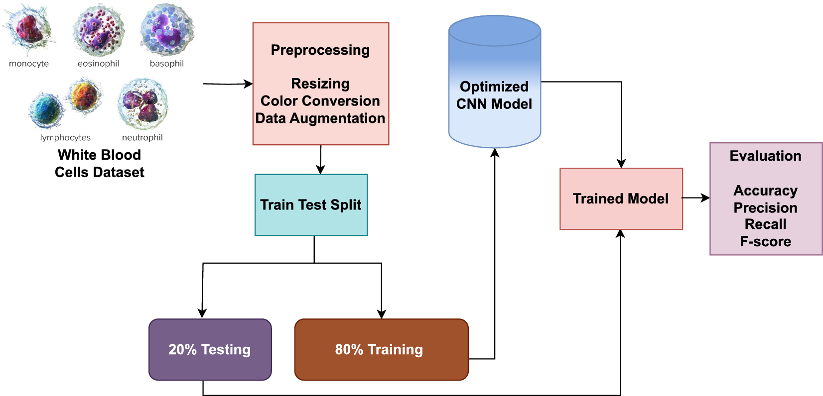
Proposed Model Architecture
Proposed Model Architecture:
credit: nature.com

Slide 9
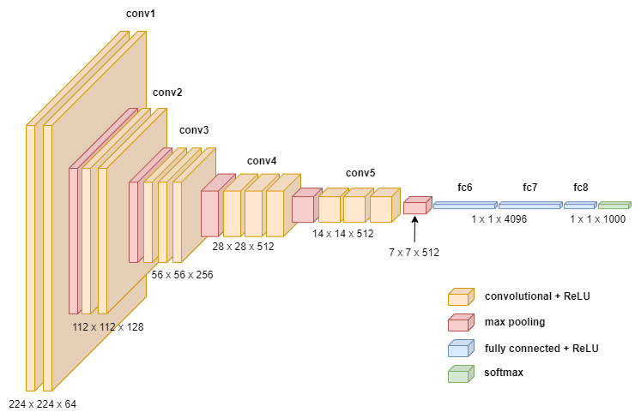
Model: Convolutional Neural Network Architecture:
credit: towardsdatascience

Slide 10
Results
Model Name | Train Accuracy | Training Loss | Validation Accuracy
DNN | 68.43% | 78.67% | 68.53%
CNN | 98.18% | 8.81% | 88.60%
VGG16 | 99.87% | 1.85% | 94.62%
VGG19 | 90.67% | 28.77% | 87.76%
ResNet50 | 37.77% | 188% | 39.37%

Slide 11
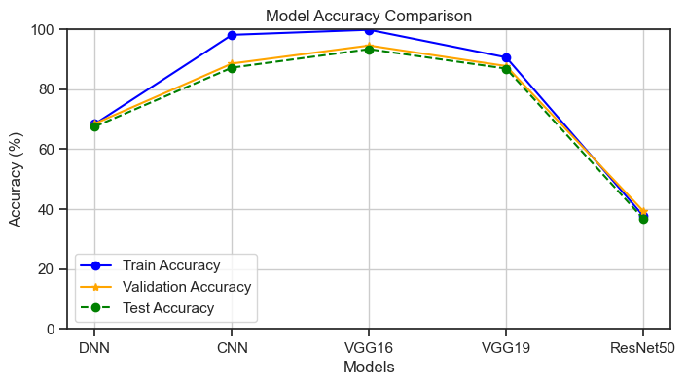
Result
Accuracy for different model generations on training, validation, and test data sets.

Slide 12
Results
Classification reports and the number of instances for each class of VGG16 model
Class Name | Precision | Recall | F1-Score | Support
Basophil | 0.91 | 0.95 | 0.93 | 237
Eosinophil | 0.95 | 0.98 | 0.97 | 596
Erythroblast | 0.91 | 0.96 | 0.94 | 294
Ig | 0.89 | 0.88 | 0.88 | 602
Lymphocyte | 0.96 | 0.88 | 0.92 | 241
Monocyte | 0.89 | 0.84 | 0.86 | 307
Neutrophil | 0.94 | 0.95 | 0.94 | 679
Platelet | 0.99 | 1.00 | 0.99 | 462
Accuracy |  |  | 0.93 | 3418
macro avg | 0.93 | 0.93 | 0.93 | 3418
weighted avg | 0.93 | 0.93 | 0.93 | 3418

Slide 13
Conclusion & Future Direction
This project showed that deep learning models, including deep neural networks (DNNs), convolutional neural networks (CNNs), and ResNet50, can accurately tell apart different types of white blood cells from images.
The high accuracy we achieved proves that using pre-trained models for medical image tasks works well and can help improve how we diagnose blood-related conditions.
In the future, additional models will be compared to determine the best one for classifying white blood cells. These findings will be submitted to a conference, contributing to advancements in medical image analysis and potentially improving clinical practices.

Slide 14
References
[1] Abdullah, E. & Turan, M. K. Classifying white blood cells using machine learning algorithms. Int. J. Eng. Res. Dev. 11, 141–152 (2019).
[2] Bagido RA, Alzahrani M, Arif M. White blood cell types classification using deep learning models. IJCSNS Int J Comp Sci Netw Secur. 2021;21:223 Available at: https://doi.org/10.22937/IJCSNS.2021. 21.9.30
[3] Macawile MJ, Quinones VV, Ballado A, Dela CJ, Caya MV. White blood cell classification and counting using convolutional neural network. 2018 3rd international conference on control and robotics engineering (ICCRE). IEEE; 2018. p. 259–263. Available at: https:// ieeexplore.ieee.org/document/8376476/
[4] Ma L, Shuai R, Ran X, Liu W, Ye C. Combining DC-GAN with ResNet for blood cell image classification. Med Biol Eng Comput. 2020;58: 1251–64. Available at: http://link.springer.com/10.1007/s11517- 020-02163-3
[5] Almezhghwi K, Serte S. Improved classification of white blood cells with the generative adversarial network and deep convolutional neural network. Comput Intell Neurosci. 2020;2020:1–12. Available at: https://www.hindawi.com/journals/cin/2020/6490479/

Slide 15
References
[6] Siddique MAI, Bin AAZ, Matin A. An improved deep learning based classification of human white blood cell images. 2020 11th international conference on electrical and computer engineering (ICECE). IEEE; 2020. p. 149–152. Available at: https://ieeexplore.ieee.org/ document/9393156/
[7] https://onlinelibrary.wiley.com/cms/asset/898be9f9-cc38-44ec-bd05-4131a252cef3/cytoa24839-fig-0002-m.jpg
[8] https://towardsdatascience.com/how-to-easily-draw-neural-network-architecture-diagrams-a6b6138ed875
[9] https://www.researchgate.net/figure/ResNet50-architecture-22_fig1_372274736

Slide 16
Thank you

